Slide 1
COUNTY CONNECTION Transit Talks: COVID-19 Vaccine & Testing Policies
September 29, 2021

Slide 2
COVID-19 Response
Continued service to essential workers and communities of concern which are transit dependent.
County Connection’s paratransit division began the essential transportation of COVID-19 positive individuals to medical facilities and hotels. LINK Paratransit has transported over 450 COVID positive passengers.
Delivery resources to food and meal programs in the entire County, not just the County Connection service area.
Continued partnership with the County in developing opportunities to assist with the COVID vaccines.

Slide 3
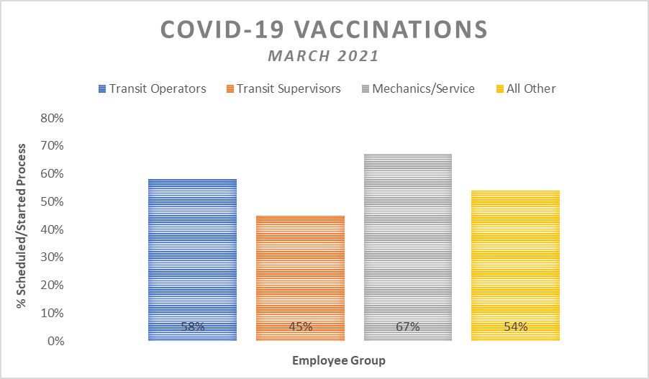
COVID-19 Vaccines at County Connection
COVID-19 vaccine appointments allotted to County Connection employees by the County
Vaccination Priority
Age 65+ Transit Operators
Transit Operators
Transit Supervisors
Mechanics & Service Workers
All Other Staff
58% scheduled for first dose or began the process (i.e., with their own healthcare provider)

Slide 4
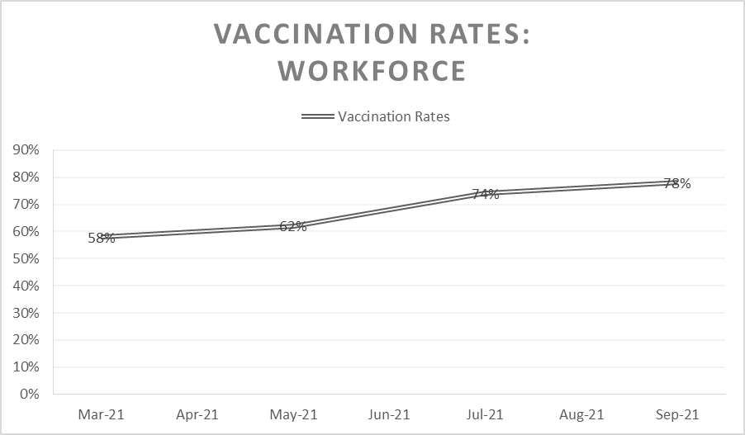
COVID-19 Vaccine Timeline
March 15, 2021: Public transit workers eligible for COVID-19 vaccination
County Connection offers $100 incentive to employees upon receiving the vaccine
Proof of completed vaccination card documented by HR
Masks continue to be required on all County Connection buses and in all County Connection buildings regardless of vaccination status.
June 15, 2021: Social distancing for passengers ends
Masks are required for all employees and passengers on public transit per Federal Mandate

Slide 5
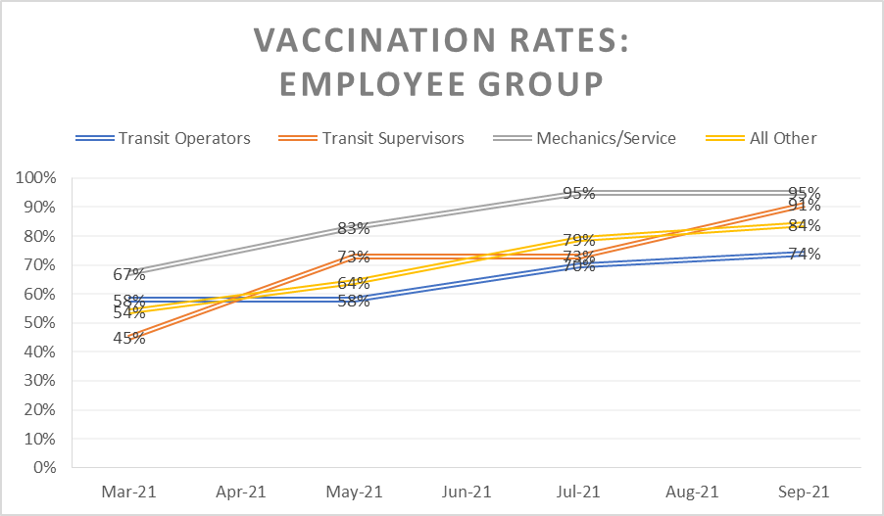
COVID-19 Vaccine Timeline
June 17, 2021: Cal OSHA COVID-19 Prevention Emergency Temporary Standards (ETS) updated to include requirements for vaccinated and unvaccinated employees
County Connection employees who are fully vaccinated no longer required to wear face coverings (except on buses)
Social distancing no longer required
July 22, 2021: Contra Costa Health officials urge all employers to consider vaccine requirement for employees following rise in COVID cases
August 2, 2021: Bay Area Health officials issue order requiring face covering indoors regardless of vaccination status.

Slide 6
COVID-19 Vaccine Policy
Two draft policies under consideration
Option 1: All employees must be vaccinated following final approval by FDA of two or more COVID-19 vaccines
Current workforce
Option 2: Weekly testing for existing unvaccinated employees
Administrative management
Cost analysis
Testing sites
All new hires must submit proof of COVID-19 vaccination prior to the start of employment
Other Considerations
Federal/State Mandates

Slide 7
Continued COVID-19 Initiatives
Regular weekly COVID-19 meetings
Regular updates from Human Resources to all employees
Local/Regional Efforts
Sharing of best practices
Webinars
Committees/Groups

Slide 8
Thank You!
For questions, please contact:
Kristina Martinez
(925) 680-2031
kmartinez@cccta.org

